Slide 1
Solid Edge Part and Sheet Metal Automation
Greg Chasteen, Technical Account Manager, Siemens PLM Software

Slide 2
Agenda
Create a Solid Part Model using API
Know object browser
Write code using IntelliSense and code snippets
Create Swept Surface
Create Protrusion
Specify Reference Plane
Draw Profile Geometry
Create The Protrusion
Adding a Lofted Cutout
Close and Save The File
Create Synchronous Version of the Drill
This presentation will mainly use Visual Basic delivered with Visual Studio 2012.

Slide 3
Creating a Solid Part Model Using API
When you create a model interactively, you always begin by creating a base feature. You then add subsequent features to this base feature to completely define the model. When you create a model using automation, the workflow is identical. Using add methods on the Models collection, you first create a base feature commonly using either an extruded or revolved protrusion.
To create a feature interactively, you need to:
Select or create a reference plane to draw a profile
Draw the profile consisting of lines, arcs, etc
Constrain the profile correctly
Then using the appropriate feature command with the appropriate options actually create the feature
Follow a very similar workflow using the API!

Slide 4
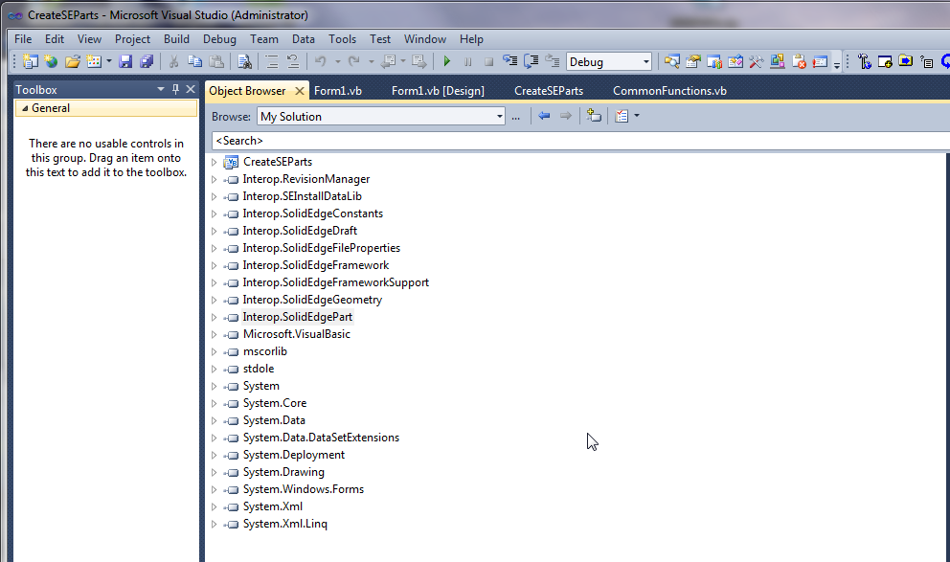
Where to Start….. Get to know the object browser!
Demo the object browser

Slide 5
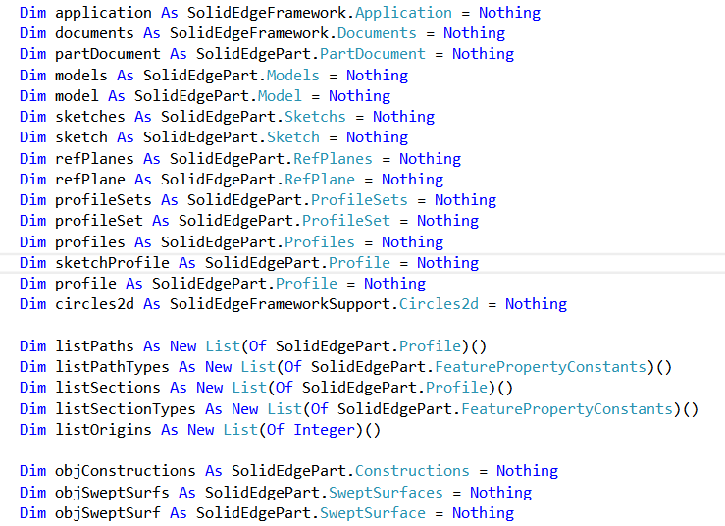
How to create Swept Surface?
Declare Variables as shown below.

Slide 6
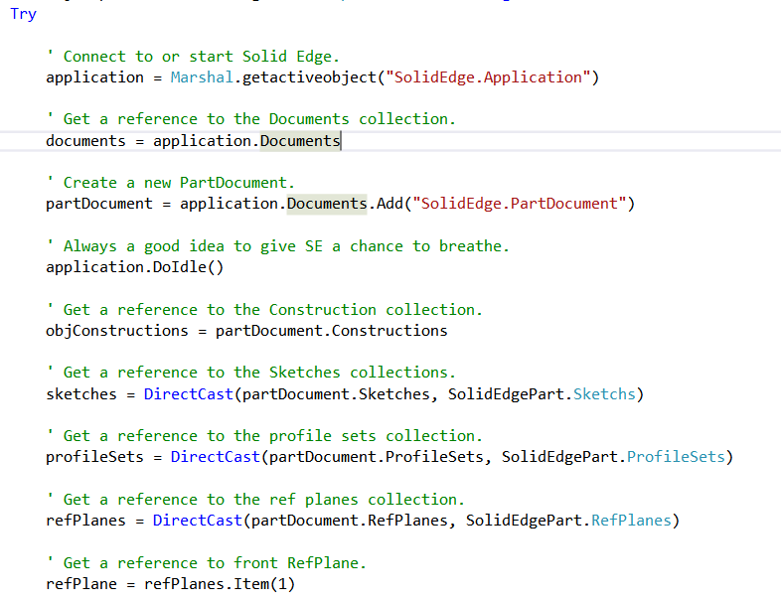
Swept Surface…………

Slide 7
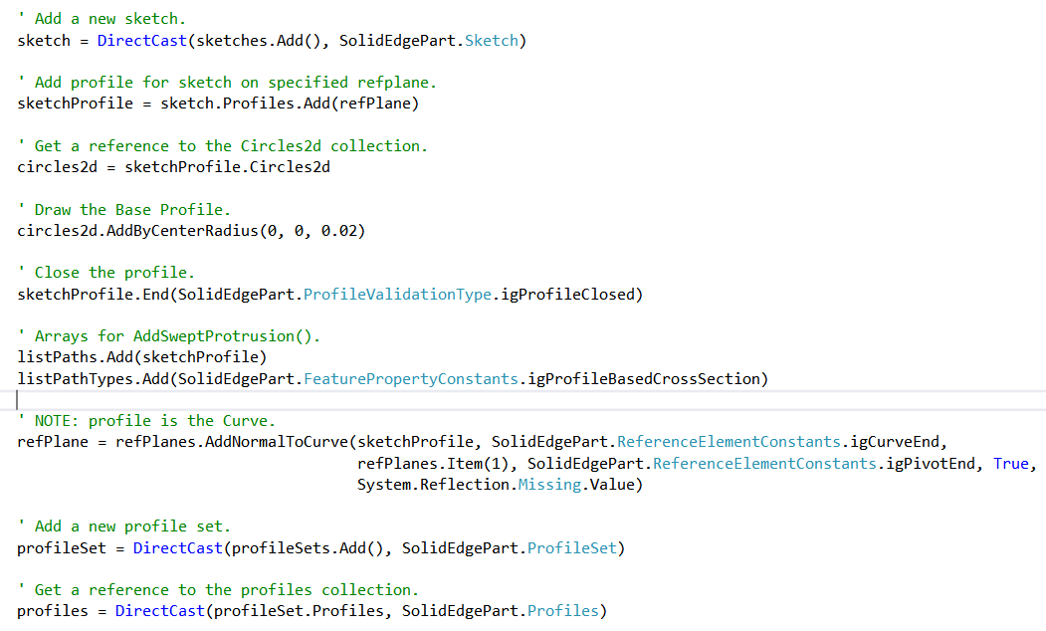
Swept Surface…………

Slide 8
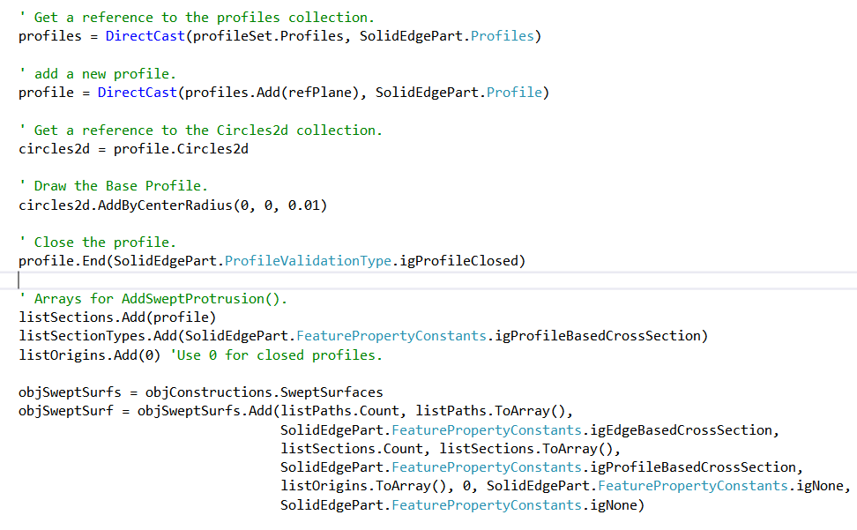
Swept Surface…………

Slide 9
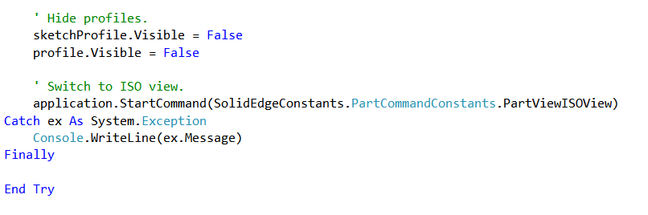
Swept Surface…………

Slide 10
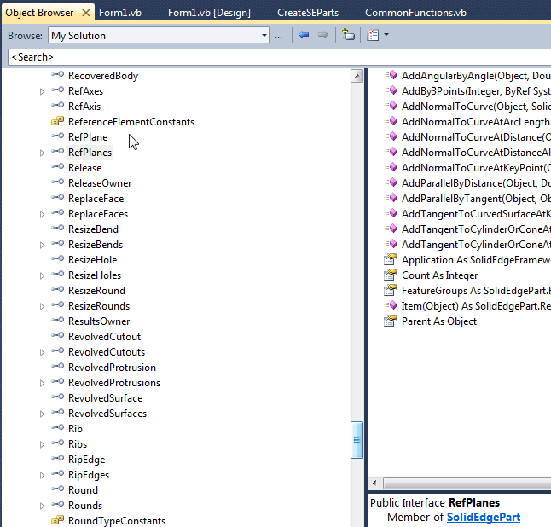
Creating a Protrusion
First need a Reference
Plane
Where is this API
located?

Slide 11
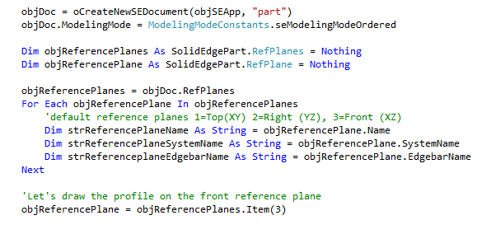
Specifying a Reference Plane

Slide 12
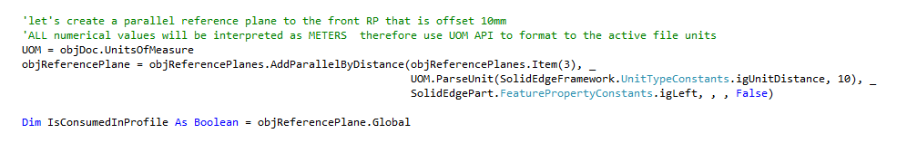
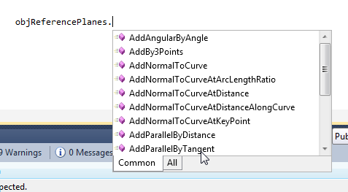
Specifying a Reference Plane
What if we wanted to create a new reference plane. Below is what it would look like to create a new standalone reference plane offset 10 mm from the front default reference plane.
Other Reference Plane
creation APIs

Slide 13
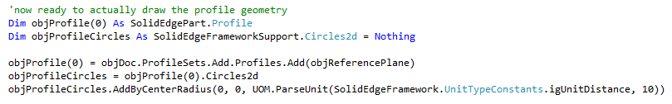
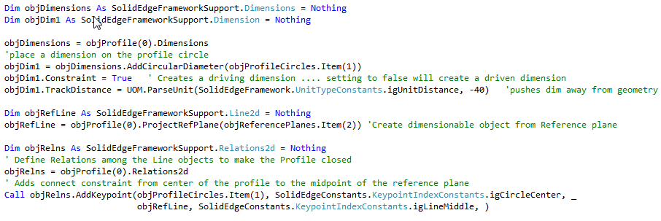
Draw Some Profile Geometry
Simply draws a circular profile
Now constrain the profile

Slide 14

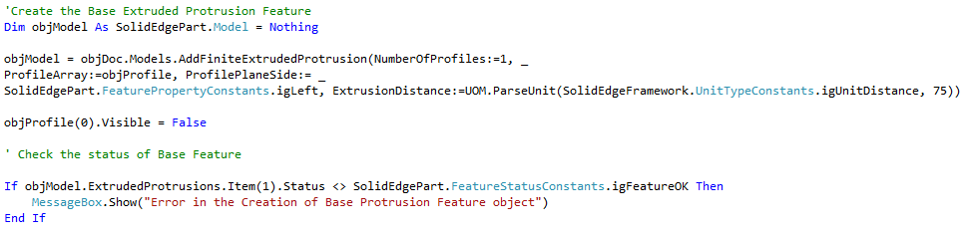
Creating the Protrusion
Finish the Profile
Now actually Create the Protrusion
Then lastly check its status

Slide 15
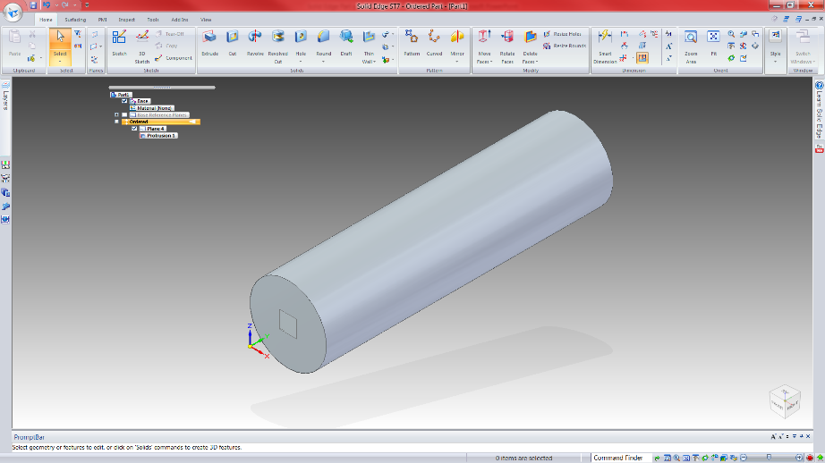
Let’s See What We Have Created so Far

Slide 16
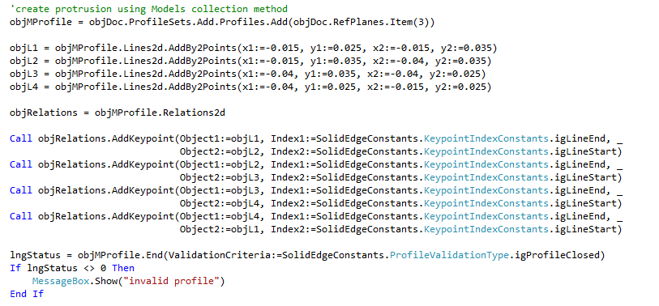
Continue On
Sample profile with multiple segments

Slide 17
Adding a Lofted Cutout
Same as previously must specify RP, draw and constrain profile, etc just like interactively
In this case:
Need 7 cross sections where the start and end cross sections are fixed…. The 5 in between are spaced evenly.

Slide 18
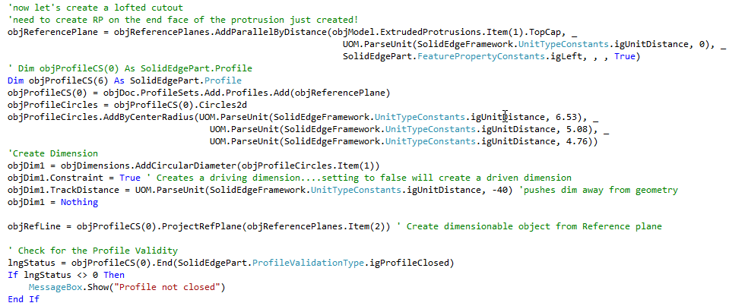
Adding a Lofted Cutout
First cross-section

Slide 19
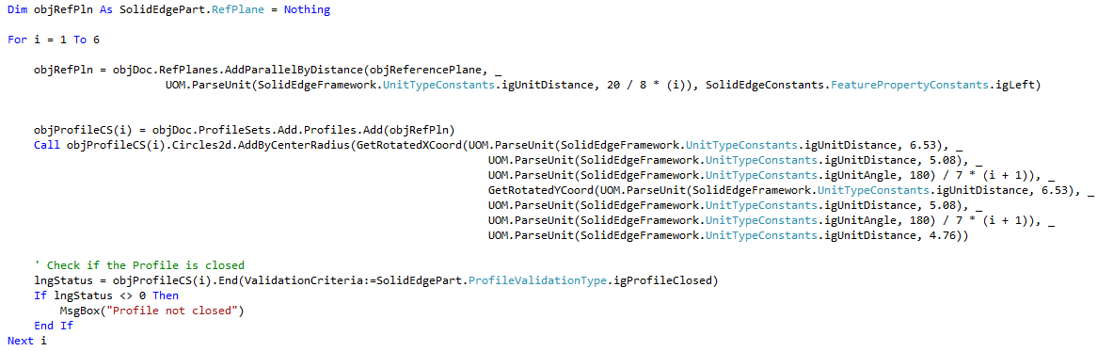
Adding a Lofted Cutout
Loop to create the next cross sections

Slide 20
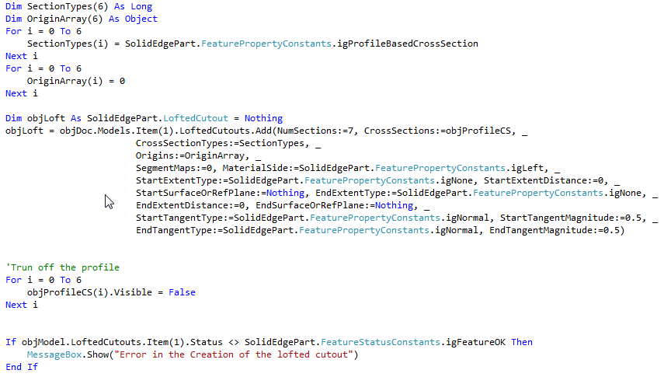
Adding a Lofted Cutout
Create the lofted cutout

Slide 21
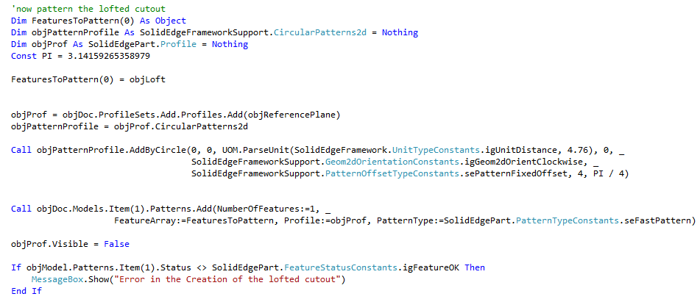
Adding a Lofted Cutout
Now Pattern the lofted cutout

Slide 22
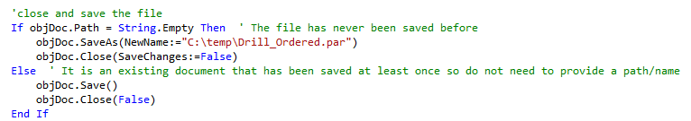
Close and save the file
Save an close the Solid Edge part file.
Notice the method to check if new file or existing file!

Slide 23
What About a Synchronous Model
The goal is to make the Part API’s transparent to whether you are in synchronous or ordered mode.
The reality is there are a some places where there are differences
The command in the UI has different options depending on whether sync or ordered
One example is feature pattern command… the pattern feature command in ordered has an option for fast or smart pattern. The corresponding Synchronous pattern feature does not!
Other areas that will be slightly different are things involving faces that belong to “features”
And others!

Slide 24
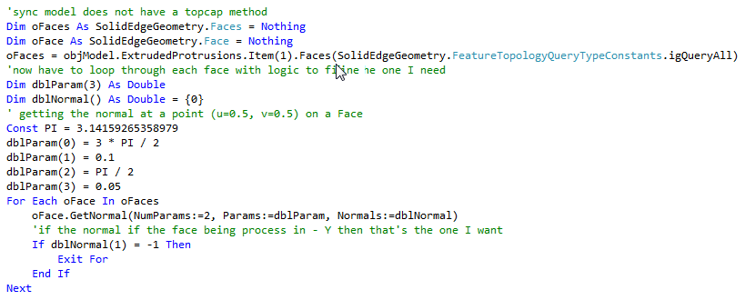
Creating the Synchronous Version of the Drill
The ordered model example
A synchronous model will not have this API. Instead you will need to add logic to your program to identify the necessary face. Obviously, each case will be different depending on the geometry and the need.

Slide 25
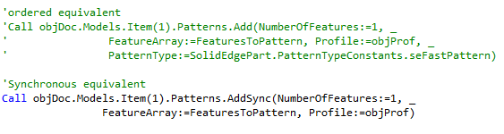
Creating the Synchronous Version of the Drill
In this particular case this were the only two modifications needed between Ordered and synchronous.

Slide 26
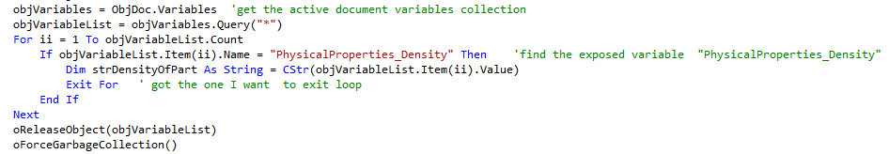
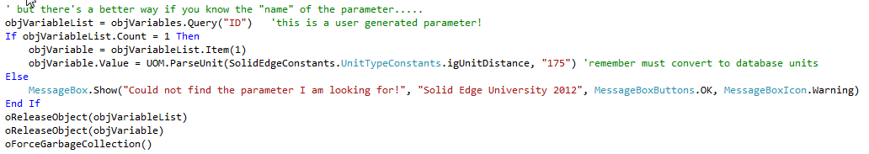
How to Modify Parameters of a Part
You can Modify Variables

Slide 27
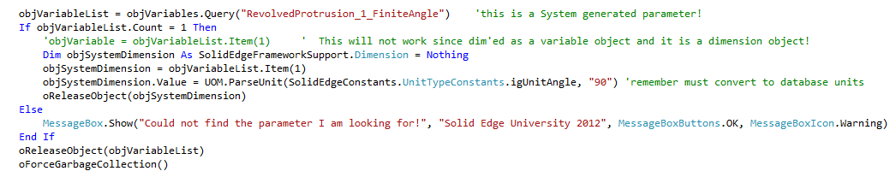
How to Modify Parameters of a Part
You can modify Dimensions

Slide 28
API tip -- Unit Of Measure Management
Solid Edge (database units) units are:
Length: meters
Mass: kg
Volume: m^3
UOM Functions
ParseUnit
Converts user specified units to Solid Edge database units
FormatUnit
Find what Solid Edge will report (not database, but from properties

Slide 29
Contact
Greg Chasteen
Technical Account Manager
Siemens PLM Software
675 Discovery Drive, Suite 100
Huntsville, Al 35806
Office: (256) 705-2621
Cell:(256) 479-9055
E-mail:
chasteen.gregory@siemens.com

